Slide 1
Chapter one
Mole Balances

Slide 2
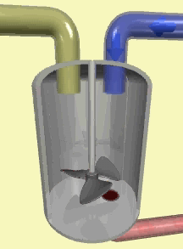
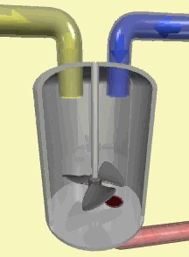
1.3 Batch Reactor
Nor inflow neither outflow of reactants and products while reaction is being carried out
Used for small scale operation
Used for lab experiments
Used for expensive products

Slide 3
Batch Reactor
for perfectly mixed reaction mixure the reaction rate is same throughout the reactor volume, Then integral equation becomes
Where t is the time required to change the number of moles from Nj0 to Nj1

Slide 4
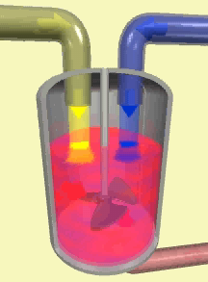
1.4 Continuous Flow Reactor
1.4.1 Continuous Stirred Tank Reactor (CSTR)
  Used for liquid phase reactions
  Operated at steady state
  Perfectly mixed (all variables are the same everywhere)

Slide 5
The general mole balance is
For steady stae
For perfecly mixing
The design eq. that gives the necessary volume to reduve the flow rate of species j from Fj0 to Fj

Slide 6
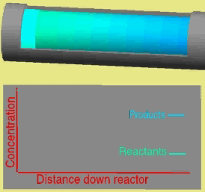
1.4.2 Tubular Reactor
Consists of cylindrical pipe
Operated at steady state
The reactants are continually consumed as they flow down the length of the reactor
Concentration varies only axially
Used for gas phase reactions

Slide 8
The mole balance around ΔV
In - Out + Generation = Accumulation
Divide by ΔV and take limit as ΔV→0

Slide 9
For the reaction A→B
This equation is used to find the volume necessary to reduce FA0 to FA and produce FB1

Slide 10
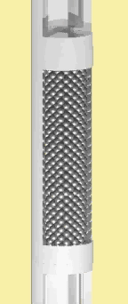
1.4.3 Packed Bed Reactor
Fluid solid heterogeneous reaction takes place on the surface of the catalyst
Reaction rate (-rA’)=mol A reacted/s.g catalyst

Slide 11
The mole balance around ΔW
In - Out + Generation = Accumulation
Divide by ΔW and take limit as ΔW→0

Slide 12
For the reaction A→B
This equation is used to find the catalyst weight necessary to reduce FA0 to FA

